Slide 1

South Dakota Trust Law: Pulling Back the Curtain
A Soup to Nuts Tour of South Dakota Trust Law
by Patrick Goetzinger
Denver Estate Planning Council
November 2018
Patrick@gpna.com
605-342-1078

Slide 2
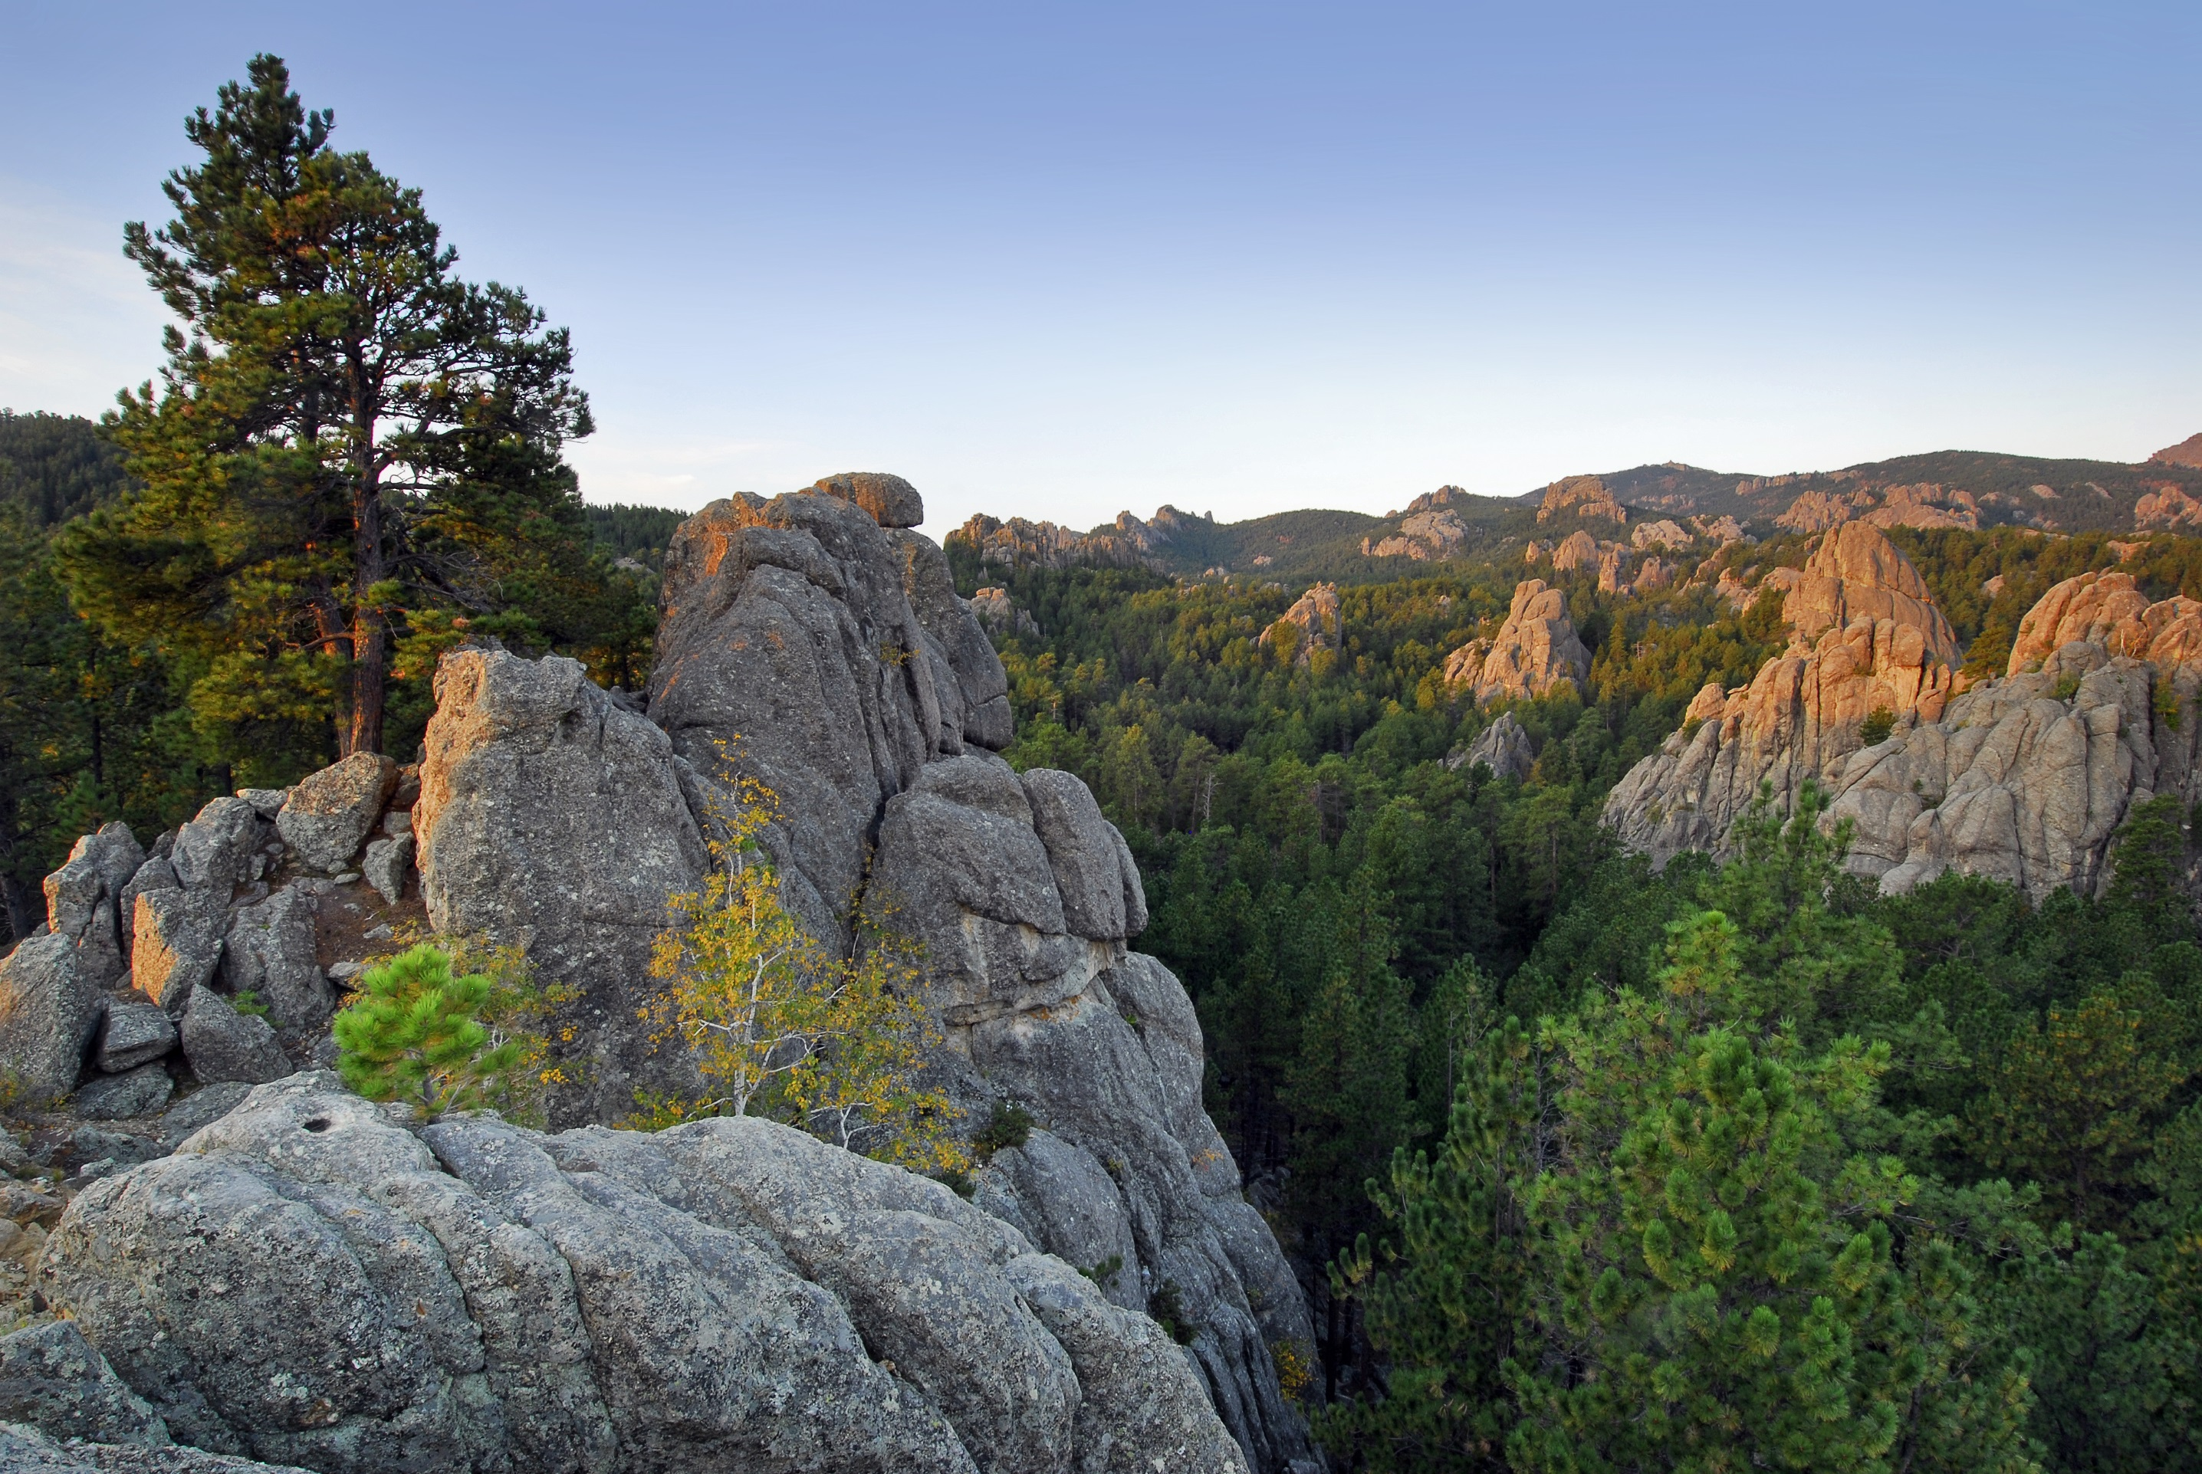
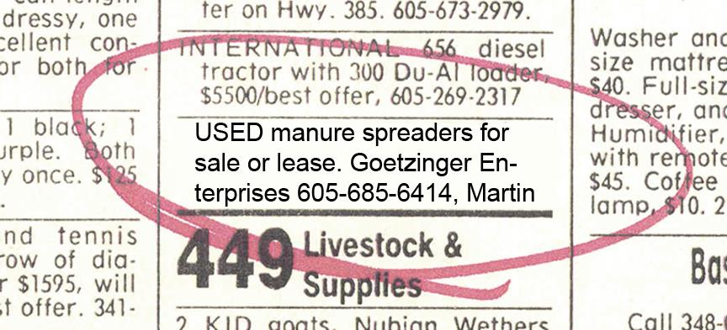
YOUR SPEAKER’S LEGACY

Slide 3
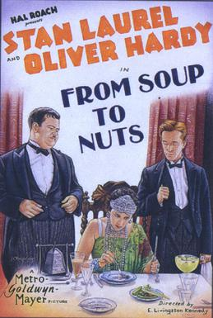
From Soup to Nuts
From Soup to Nuts, is a 1928 short comedy film starring Laurel and Hardy as butlers hired for a high society dinner party.

Slide 4
SOUTH DAKOTA’S FISCAL SOUNDNESS
Constitutional requirement to balance budget
Healthy surplus in General Fund
Best Bond Rating
A top performing State Retirement Fund
Constitutional prohibition on inheritance & estate taxes

Slide 5
…ATTRACTS CAPITAL
SD Consistently ranked among best places to live & conduct business
SD leads the nation in total bank assets w/ $2.9 Trillion
#2 = DE w/ $980B
#3 = NY w/ $934B

Slide 6
Deep Affection for South Dakota Among Trust Clients & Advisors
YEAR | # OF STATE CHARTERED TRUST COMPANIES | ASSETS
1996 | LESS THAN 5 | LESS THAN $1 BILLION
2001 | 13 | $12.7 BILLION
2011 | 55 | $104 BILLION
2018 | 99 (Numbers do not include banks) | $293.5 BILLION (as of 2017)

Slide 7
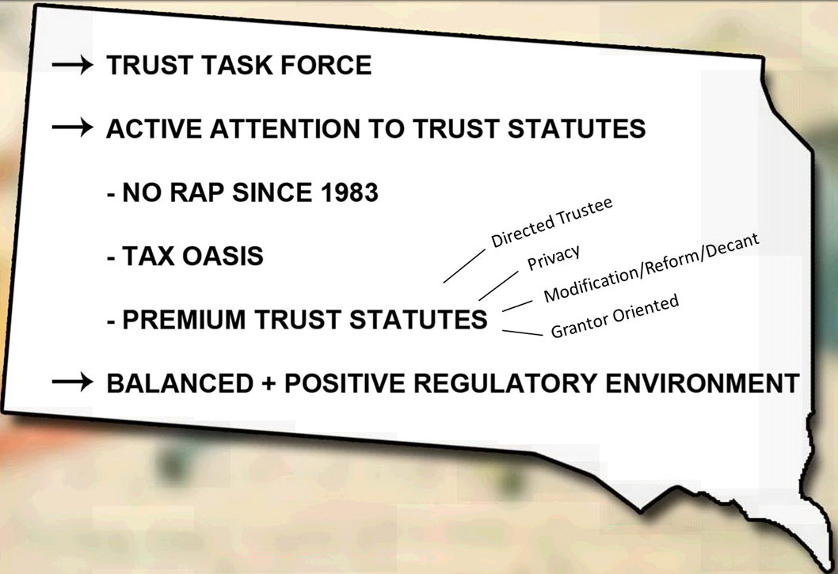
Why SD is the #1 Ranked Trust Jurisdiction
Grantor Sovereignty
Positive Business Environment
State by state comparison in January 2016 Trusts and Estates
“Which Situs is Best? “ Article

Slide 8
Why put your trust in South Dakota?
Because you can efficiently & effectively.
As told by the fedgazzette, April 2013,
  “South Dakota has become a trust company magnet because it has configured an attractive regulatory environment for trusts…”
South Dakota has maintained it’s advantage through the constant attention of the Trust Task Force & the annual legislative package that keeps South Dakota at the forefront of innovation in an ever evolving trust and economic environment.

Slide 9
Grantor Sovereignty- The Lynch Pin
“She who has the gold makes the rules.”
Assures trust terms reflecting the grantor’s wishes will be respected
Protection from creditors, predators, in-laws & outlaws
Contrast with statutory regimes that favor beneficiaries
Statutory authority: SDCL 55-4-30; 55-5-12; 55-1B-1.1; 55-1-53

Slide 10
CONFIDENTIALITY & PRIVACY
RESPECTED & PROTECTED UNDER SD LAW W/ ROBUST STATUTES
Legal proceedings sealed, but open to interested parties
Limit beneficiary rights to information
Balanced Rules, NOT nefarious secrecy:
  Aggregate AUM & bank franchise tax paid is public information
  T/C subject to rigorous application process & background checks
  Trust Companies are audited by SD DOB
  T/C must have SD presence and deep connections to SD
  T/C subject to: know your customer rules; FBARs; SARs; SOS disclosures
  SD is far away from Panama and is NOT Wyoming or Nevada

Slide 11

South Dakota Situs Rules
How to achieve application of SD law by establishing SD situs
The North Star
Well Established & Clear Rules on Applying SD Trust Law to a Trust
The Road Map: SDCL 55-3-39 thru 44 & 55-3-48
  Trust assets located in South Dakota
  Qualified Trustee per SDCL 55-3-41
  Trust Administration in SD (Per SDCL 51A-6A-11.1& ARSD)
Migrating old trusts to SD: Pitching & Receiving concepts

Slide 12
The SD Trust Rush
Has its roots in the Dynasty Trust (AKA Legacy Trust & Perpetuities Trust)
A Trust w/ unlimited duration
Remove assets from transfer tax systems forever
BEWARE the Unconstitutional Perpetuities Trust Argument
  2014 Vanderbilt Law Review Article compared state law w/ state constitution
  NOT: Nevada, Wyoming, AZ, TN, NC
  HOT: SOUTH DAKOTA, NH, DE
Not only another trust planning option, but an illustration of which states do it right
SD was the 1st state to authorize a perpetual trust
RAP repealed in 1983 predates 1986 GST Tax
Non tax reasons guard against risks posed by Predators, Creditors, In-laws & Outlaws

Slide 13
Spendthrift & Third Party Discretionary Support Rules
1st of its kind in the Nation Statutory regimen to protect assets in a 3rd party Beneficiary Trust
A super charged Spendthrift Trust
Finding protection against creditors in a trust lacking precise spendthrift $
Statutory preclusion to the judicial application of:
  The Restatement of Trusts (Third)
  Uniform Trust Code
  Which are both decidedly pro-creditor
Distinguishing Distribution Interests Parsing the Trustee’s Discretion
  Mandatory Interest
  Support Interest
  Discretionary Interest

Slide 14
Is it Possible…
For a Grantor to form a Trust?
Transfer assets she owns to the trust
Name herself as a beneficiary
Receive an income stream from the Trust
Protect the Trust assets from the Grantor’s creditors, and
Do all this without going to jail?

Slide 15
YES! It is Possible…
Domestic Asset Protection Trusts (DAPTS)
  A Revolutionary Concept in Camouflage (Since 2005)
  Alaska-1st state in 1997
    AKA Self Settled Trust
    Distinguish from a Third Party Discretionary Trust with Spendthrift $
    Statutory $ Qualified Dispositions in Trust
    Hybrid DAPT – Trust Protector has discretion to add grantor later
    Estate Exclusion DAPT – Remove assets from estate of grantor
    Requires spousal consent before transferring assets to a DAPT

Slide 16
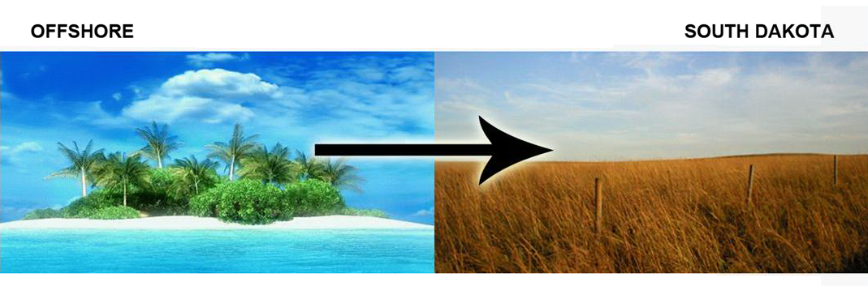
What was Previously Only Available Offshore
A creature of State Law Chapter SDCL 55-16
BEWARE: UVTA The Game of Cat & Mouse Continues!
SD Response: Strong public policy & conflict of laws statutes to assure SD law applies to DAPT

Slide 17
Special Spousal Property Trust
Virtual Community Property Designation for Select Assets
South Dakota Version of the Community Property Trust
  Joins Alaska and Tennessee in authorizing such trusts
  South Dakota is NOT a community property state
General Rule: Community Property assets receive a 100% stepped up cost basis upon the death of the first spouse
South Dakota law authorizes married couples to form a South Dakota trust which specifically designates assets held by the trust as Community Property and achieve a 100% stepped up cost basis on the trust assets upon the death of the first spouse

Slide 18
Special Spousal Property Trust
Virtual Community Property Designation for Select Assets
  Target highly appreciated assets:
    Marketable securities portfolio
    Tangible Personal Property
    Real Estate
    Closely Held Business Interests
    Couples from a C/P state can now create a South Dakota trust and fund it with C/P assets without giving up the advantages of C/P designation
Multiple Options on Structuring a SSPT:
  Irrevocable or Revocable
  Use within a Revocable Living Trust
  Use with Trust Holding Non-community Property Assets
    Record keeping
  Pair with a Domestic Asset Protection Trust
  Pair with a Legacy Trust
  Modify or reform an existing trust to add SSPT features
  Decant old trust to new trust with SSPT features

Slide 19
Special Spousal Property Trust
Virtual Community Property Designation for Select Assets
Risks:
  Untested
  IRS silent on tax treatment of such trusts… for 18 years and counting…
  SD lacks a c/p tradition in its state laws
Financial Risk:
  Transaction costs and costs of defense if challenged

Slide 20
South Dakota Dynamic Duo
A South Dakota Paired-up with a SD Limited Liability Entity
    LLE LLC or LLP
    The LLE owns the assets
    The South Dakota Trust is the member of the South Dakota LLE
      Single Member LLC Option
    For maximum control the LLE is a manager managed LLC with the family member the manager (or GP if an LLLP is Selected)
    Organizer Sovereignty
      She who has the gold makes the rules
      Freedom of Contract is expressly stated in state law
    Asset Protection = BEST IN THE NATION Changing Order Rules
    Sole & Executive remedy of a member’s Judgement Creditor
    Does not Permit foreclosure of a members interest
    Denies creditor legal & equitable remedies
    Prevents court from issuing broad charging orders

